Slide 1
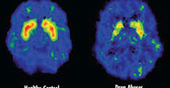
WU #5
How do drugs affect the brain?
While watching the video,
answer the following question~
Notes:
Video clip on image

Slide 2
Answer:
Dopamine=Cravings; drugs overwhelm the hotspot addiction occurs. Addiction occurs.
Drugs increase the flow of dopamine: The neurons form habits (Fun things).
Dopamine goes to the pre-frontal cortex; visualization inhibit.
Amygdala: Pleasure coated memories.
Rush re-wires to want more drugs= addiction.
Each drug interacts in different ways.

Slide 3
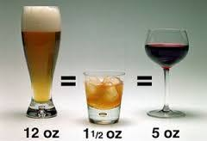
WU #6
Fill In the Blanks to make this equation correct:
__ oz of beer = __ oz of liquor =__ oz wine

Slide 4
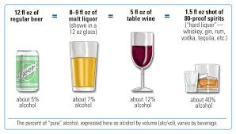
ANSWER

Slide 5
No Warm-Up Today… Group activity
Your table group will be given a scenario…
A.) Read your scenario
B.) Determine whether the teen’s drinking is affecting his/her physical health, education, social life or future.
Notes:
Video clip on image

Slide 6
Scenario #1
Samantha’s sister is annoyed with her because her drinking has gotten in the way of their old movie night tradition. Samantha has been missing more and more movie nights since she started hanging out with a new group of friends and began drinking.
Notes:
Social Life, Possibly Future

Slide 7
Scenario #2
Ben was pulled over while driving under the influence of alcohol and was charged with a DUI. As a result, he had his license suspended. Not being able to drive in the evenings means that he can’t get to his part time job at a local fast-food restaurant. He has been saving up money for college, but now he may lose his job.
Notes:
Education, Future

Slide 8
Scenario #3
Devon started hanging out with a new group of friends, and now he often spends his evenings drinking with them. As a result, he has missed several football practices. The season just began, and his coach cannot afford to have a player who doesn’t pull his weight. Devon is cut from the team.
Notes:
Future, Education and Social Life

Slide 9
Scenario #4
Kiki’s habit of having a few drinks on the weekends with her friends has gotten out of hand. Now she’s been drinking on school nights, and the hangovers she has in the mornings make it hard to concentrate in class. Recently, she failed an important test in her math class.
Notes:
Education, Future

Slide 10
Scenario #5
Seth spent a Saturday drinking with his friends and he knew he was too intoxicated to drive home. Instead, he walked home, but the weather was cold that evening. As a result, Seth caught a bad cold and had to stay in bed for several days.
Notes:
Physical Health, Education, Future

Slide 11
WU #7
Knowing what we do know about the negative health risks associated with smoking…
Why do YOU think people start smoking?

Slide 12
WU #8… Match the term with the definition
Term:
____ Bronchitis
____ Asthma
____ COPD
____ Leukoplakia
____ Emphysema
____ Carcinogen
____ Cirrhosis
Definition:
A. Destruction of alveoli (air sacs)
B. Group od diseases making breathing difficult.
C. Swelling/inflammation of bronchial tubes.
D. Buildup of scar tissue in the liver.
E. Substances that cause cancer.
F. White, leathery spots inside the mouth.
G. Airflow to and from lungs are blocked.

